Slide 1

Regression Analysis for Time Series Data

Slide 2
Regression and Time Series Regression
Time series regression usually differs from a standard regression analysis because???
The residual form a time series and therefore
tend to be serially correlated.

Slide 3
Linear Models
A model for time series {y_{t}: t = 1,…,n} is linear if it can be expressed as
where u_{i,t} is the value of the i^{th} predictor at time t (i = 1,…,m, t = 1,…,T), z_{t} is the error at time t, and α₀, α₁, …α_{m} are model parameters which can be estimated by least squares. Note that the errors from time series {z_{t}}, with mean 0, that does not have to be Gaussian or white noise.

Slide 4
Autocorrelation
The presence of autocorrelation in the errors has several effects on the OLD procedure.
1. The OLS regression coefficients are still unbiased. But they are no longer minimum-variance estimate.

Slide 5
Autocorrelation
2. When the errors are positively autocorrelated, the residual mean square may seriously underestimate the error variance σ².
3. The confidence intervals, prediction intervals, and tests of hypotheses based on the t and F distributions are no longer exact procedures.

Slide 6
Approaches
Include the “right” factors (often hard to do)
Use weighted least squares (or GLS)
Use a method of estimating the model parameters that accounts for the autocorrelation

Slide 7
Detecting Autocorrelation
Residual Plot
- If there is positive autocorrelation, residuals of identical sign occur in clusters.
- If there is negative autocorrelation, residuals will alternate signs too rapidly.

Slide 8
Detecting Autocorrelation
Durbin Watson test
Reference: Introduction to Time Series Analysis and Forecasting 2E, 2015 MJK

Slide 9
Simple linear model
A simple linear regression model with first-order autoregressive errors would be

Slide 10
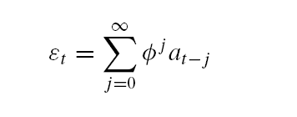
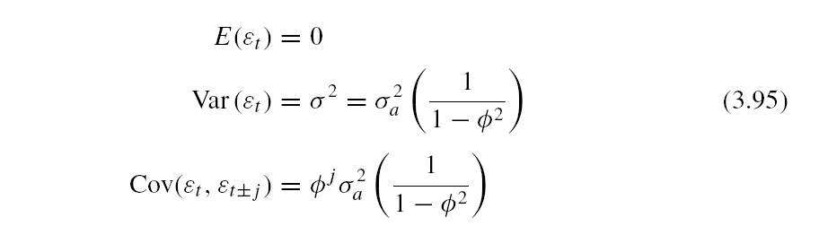
Reference: Introduction to Time Series Analysis and Forecasting 2E, 2015 MJK

Slide 11
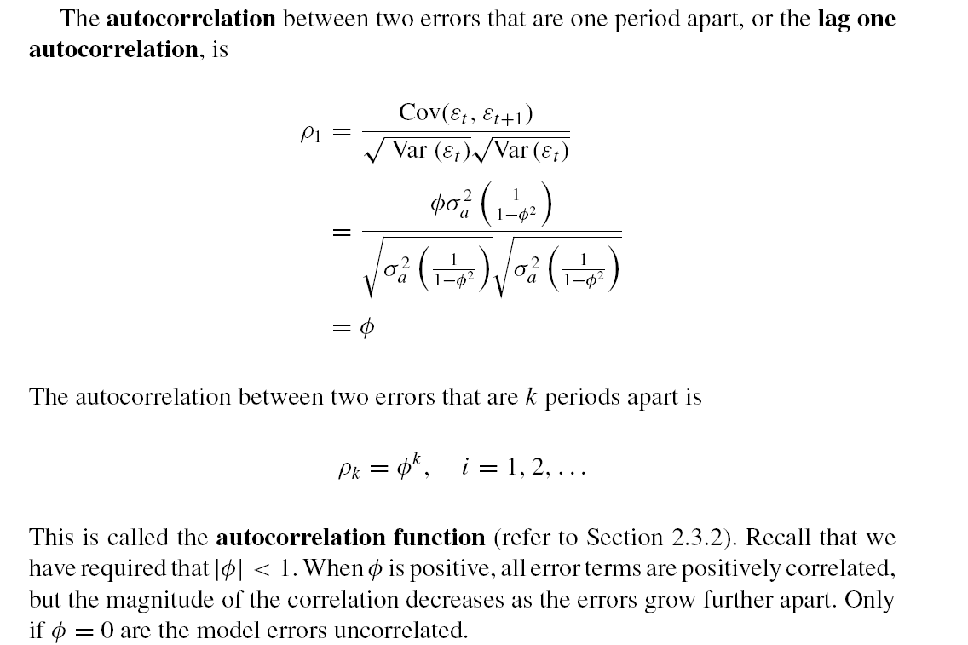
Reference: Introduction to Time Series Analysis and Forecasting 2E, 2015 MJK

Slide 12
Reference: Introduction to Time Series Analysis and Forecasting 2E, 2015 MJK

Slide 13
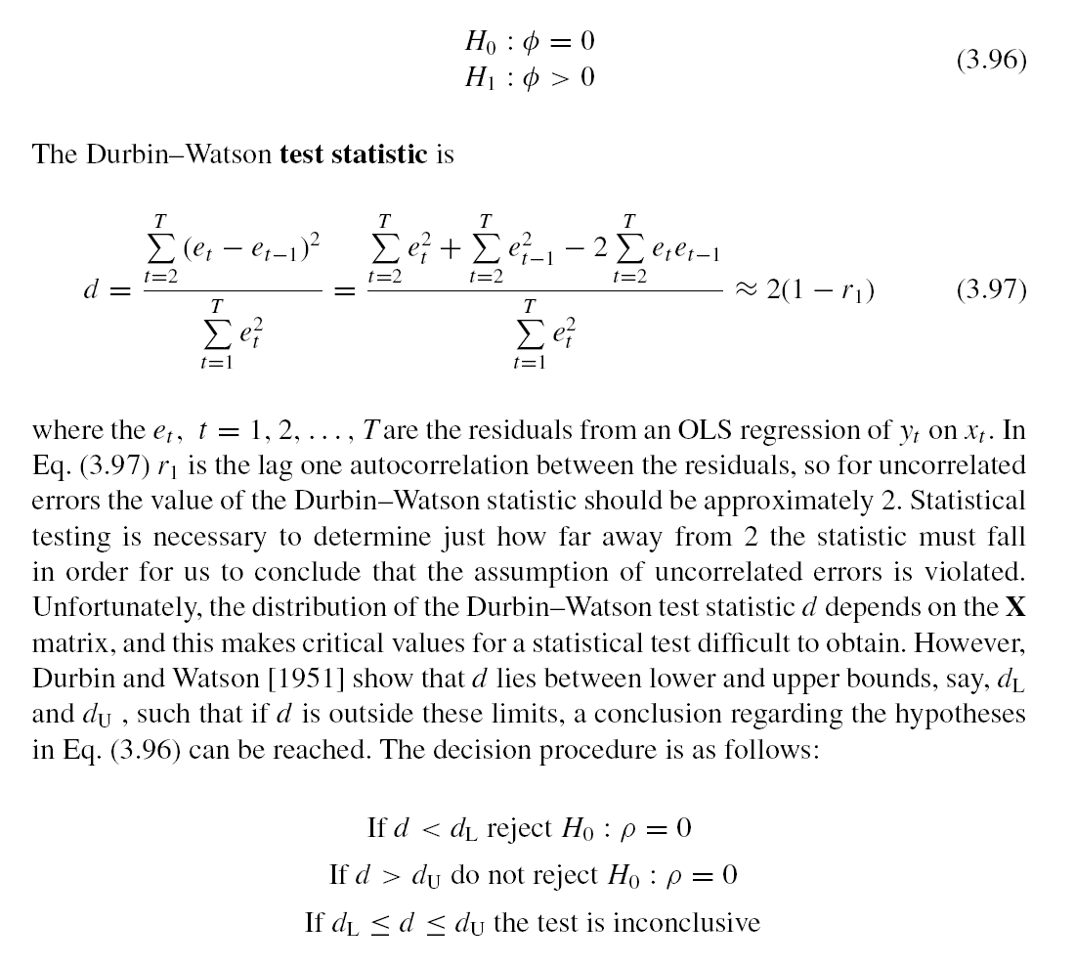
Reference: Introduction to Time Series Analysis and Forecasting 2E, 2015 MJK

Slide 14
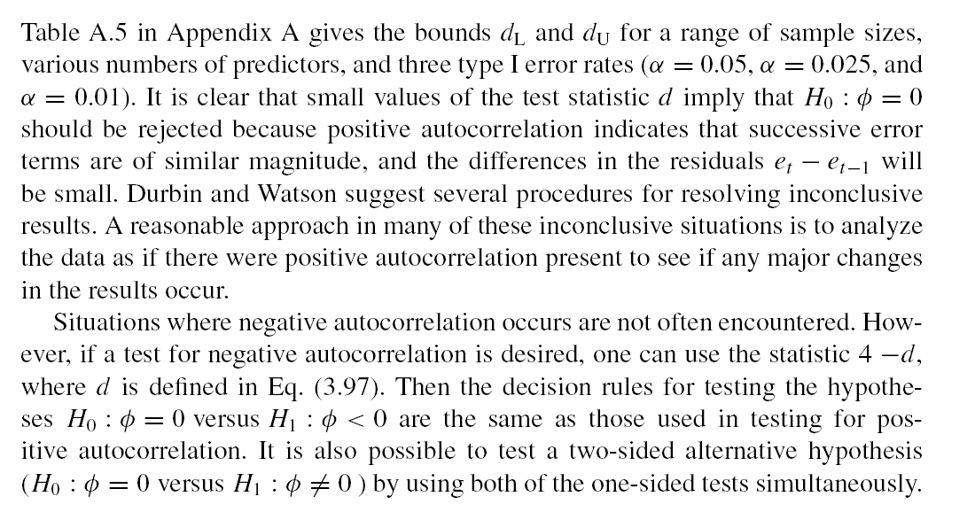
The decision procedure for Durbin-Watson is as follows.
Reference: Introduction to Time Series Analysis and Forecasting 2E, 2015 MJK

Slide 15
Reference: Introduction to Time Series Analysis and Forecasting 2E, 2015 MJK

Slide 16
Reference: Introduction to Time Series Analysis and Forecasting 2E, 2015 MJK

Slide 17
Model fitting in R
install.packages("lmtest")
library(lmtest)
drink <- read.csv("C:/MA_TS/R/drink.csv")
fit <- lm(sales~expenditures, data=drink)
summary(fit)
dwtest(fit)

Slide 18
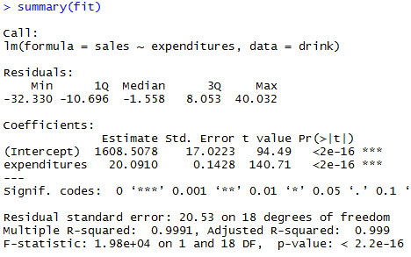

Slide 19
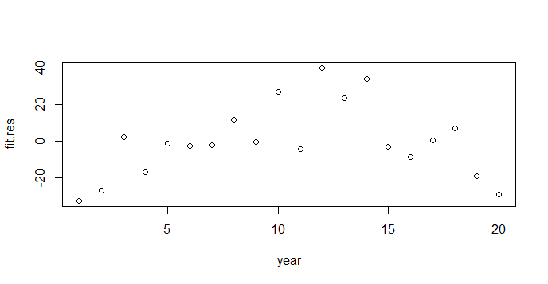
Residual Plot in R
fit.res = resid(fit)
plot(fit.res, xlab = "year")

Slide 20
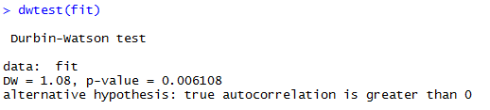
Durbin-Watson Statistic

Slide 21
Reference: Introduction to Time Series Analysis and Forecasting 2E, 2015 MJK

Slide 22
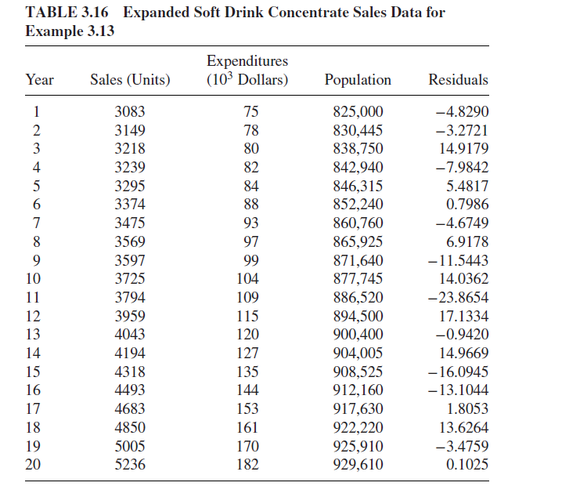
Reference: Introduction to Time Series Analysis and Forecasting 2E, 2015 MJK

Slide 23
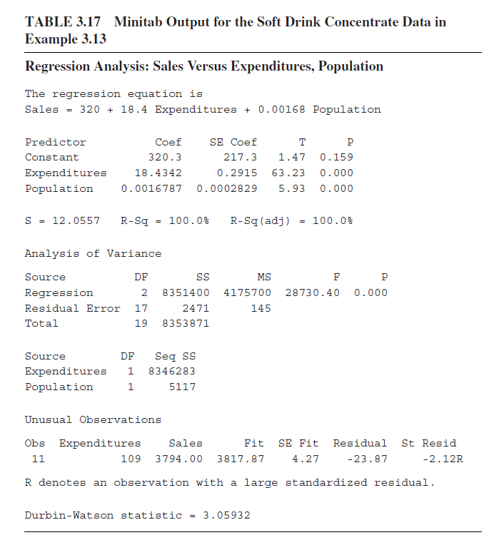
Reference: Introduction to Time Series Analysis and Forecasting 2E, 2015 MJK

Slide 24
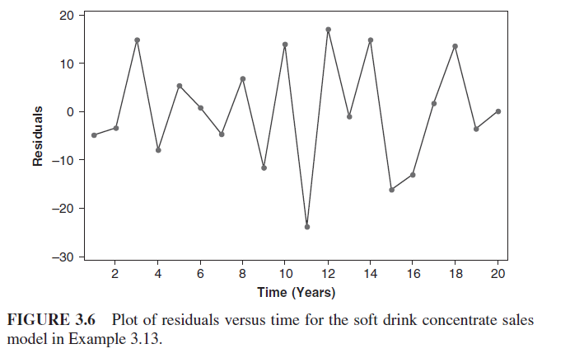
Reference: Introduction to Time Series Analysis and Forecasting 2E, 2015 MJK

Slide 25
Model fitting in R
library(lmtest)
drink <- read.csv("C:/MA_TS/R/drink.csv")
fit <- lm(sales~expenditures + population, data=drink)
summary(fit)
dwtest(fit)

Slide 26
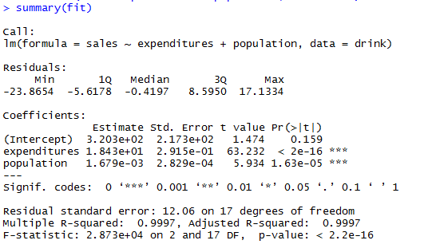

Slide 27

Durbin-Watson Statistic

Slide 28
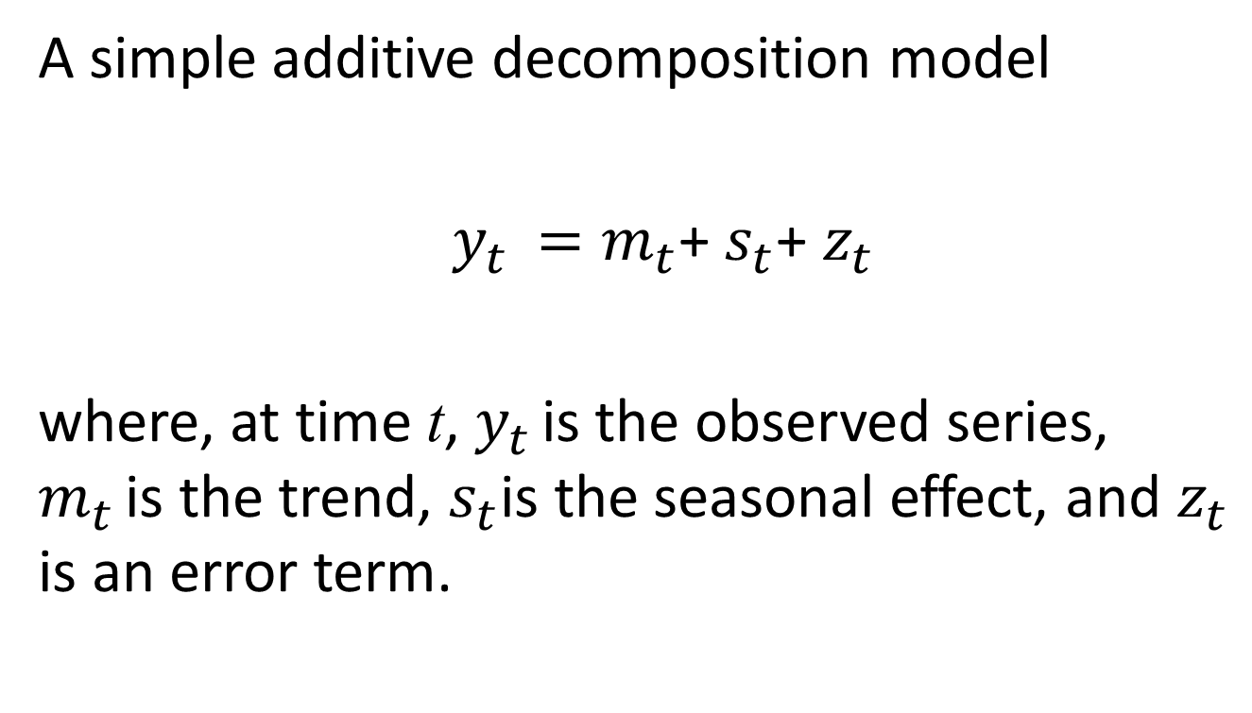
Linear models with seasonal variables
A simple additive decomposition model
$y_{t }=m_{t}$+ $s_{t}$+ $z_{t}$
where, at time t, $y_{t }$is the observed series, $m_{t }$is the trend, $s_{t}$is the seasonal effect, and $z_{t}$ is an error term.

Slide 29
Regression and Decomposition
Linear regression can be considered as a particular type of decomposition model where a function of time is used to represent the trend component, the seasonal component is estimated by dummy variables and we understand that the residuals will likely be correlated which technically violates the assumptions required for regression.

Slide 30
Linear models with seasonal variables
For example, with a monthly series beginning with t = 1 at January, a seasonal indicator model is given by

Slide 31
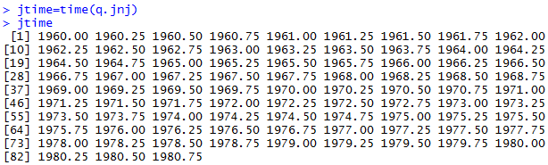
Regression Process

Slide 32

Regression Process

Slide 33
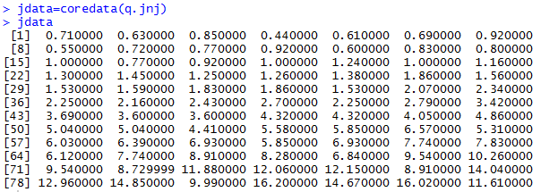
Regression Process

Slide 34
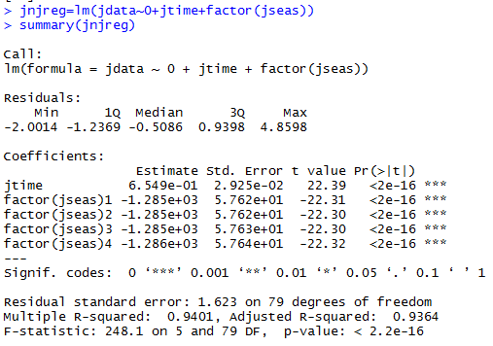
Linear trend model
The factor command creates the appropriate dummy variables for each seasonal element.

Slide 35
Linear trend model
The constant for the linear term will be incorporated into the seasonal factor
(resulting in 4 dummy variables).

Slide 36
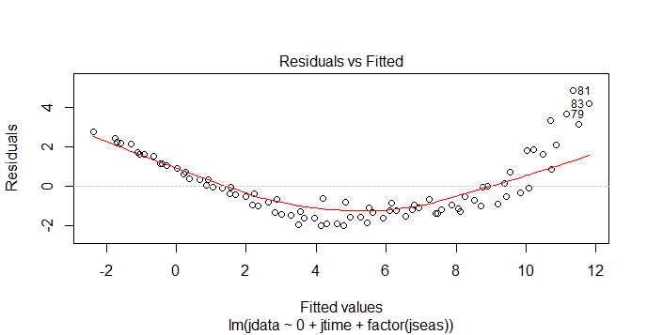
Residual Analyses
plot(jnjreg)

Slide 37
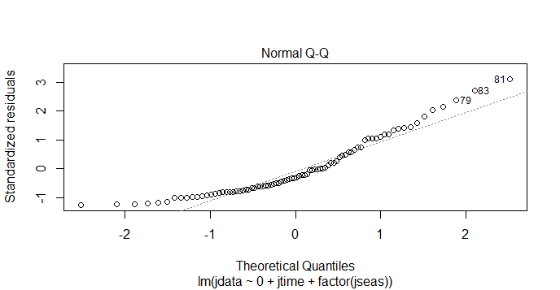
Residual Analyses

Slide 38
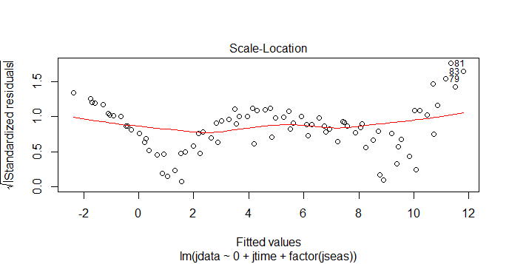
Residual Analyses

Slide 39
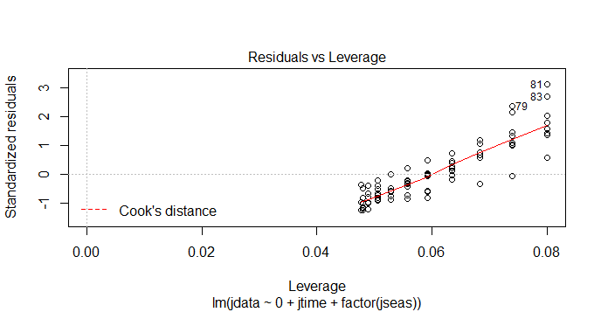
Residual Analyses

Slide 40
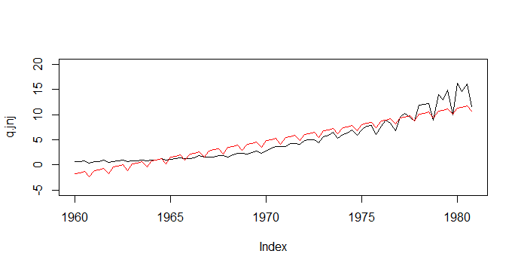
Residual Analyses
ejnj=resid(jnjreg) jnjhat=fitted(jnjreg) plot(q.jnj,ylim=c(-5,20)) lines(jtime,jnjhat,col='red')

Slide 41
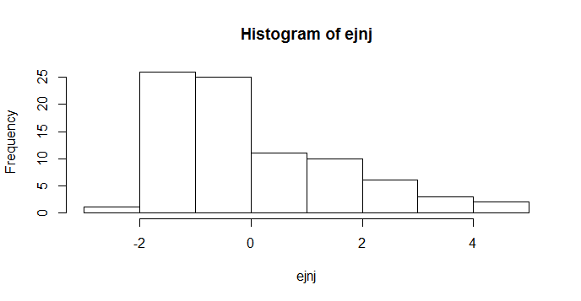
Residual Analyses
hist(ejnj)

Slide 42
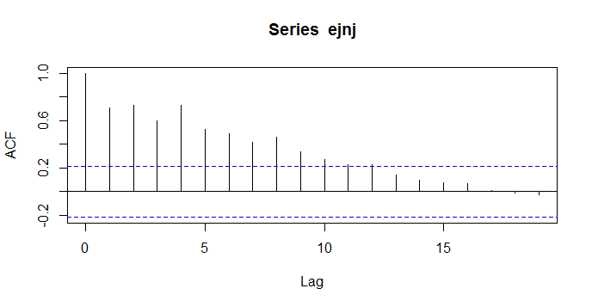
ACF
acf(ejnj)

Slide 43
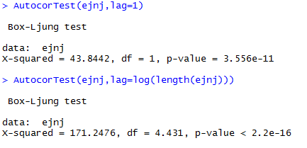
AutocorTest
The command AutocorTest tests the serial correlation in the residuals.

Slide 44
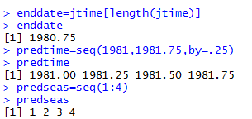
Forecasts
To compute forecasts from this model, we need to define the independet variable values associated with the forecasts we want to compute. To compute the next four values for the J&J earnings we use the following commands:

Slide 45
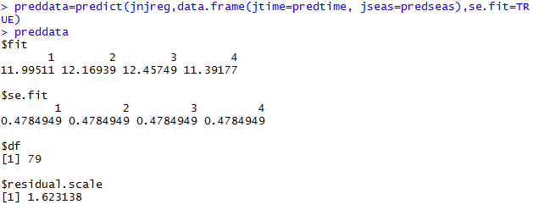
Forecasts

Slide 46
Confidence intervals
Again we can construct 95% confidence intervals for our predictions using the following commands.
predvalues=preddata$fit prederror=preddata$se.fit predupperse=predvalues+2*prederror predlwrse=predvalues-2*prederror

Slide 47
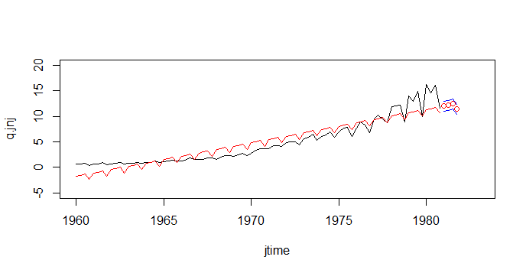
Plots
Plots can be used to visualize the forecasts.
plot(jtime,q.jnj,ylim=c(-5,20),xlim=c(1960,1983),type='l') lines(jtime,jnjhat,col='red') points(predtime,predvalues,col='red') lines(predtime,predupperse,col='blue') lines(predtime,predlwrse,col='blue')

Slide 48
Candidate model?
Based on the residual analysis, what model we should try?

Slide 49
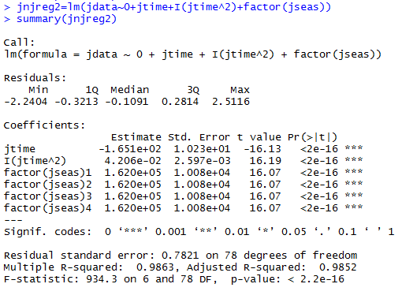
Model with quadratic term

Slide 50
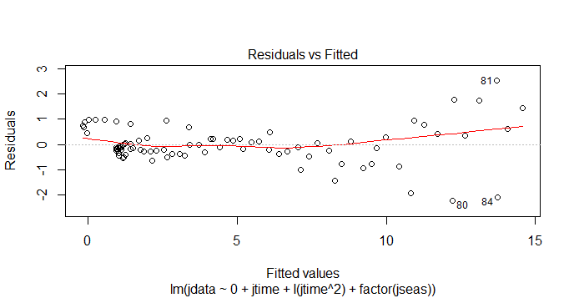
Residual analysis
plot(jnjreg2)

Slide 51
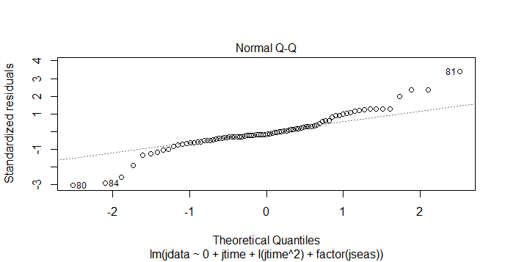
Residual analysis

Slide 52
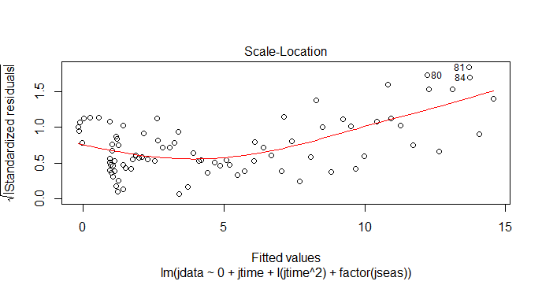
Residual analysis

Slide 53
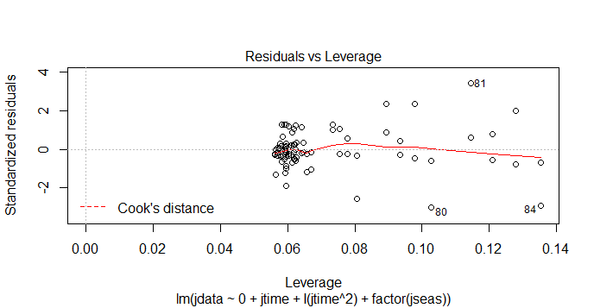
Residual analysis

Slide 54
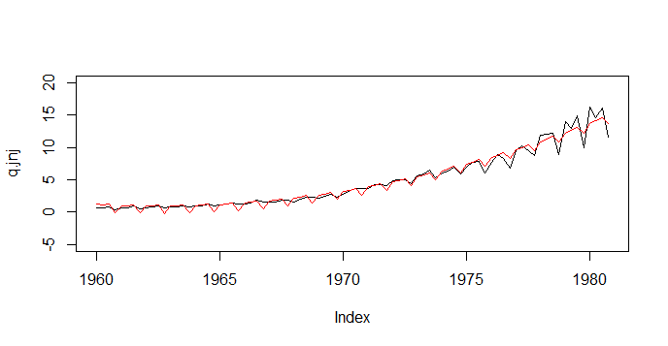
Residual analysis
ejnj2=resid(jnjreg2) jnjhat2=fitted(jnjreg2) plot(q.jnj,ylim=c(-5,20)) lines(jtime,jnjhat2,col='red')

Slide 55
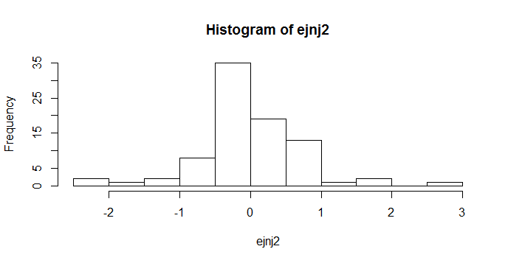
Histogram
hist(ejnj2)

Slide 56
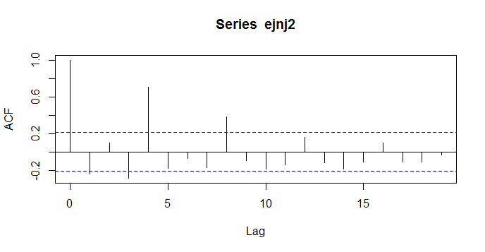
ACF
acf(ejnj2)

Slide 57
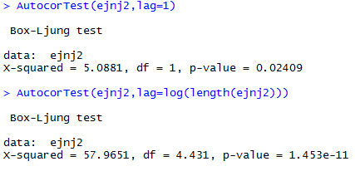
AutocorTest

Slide 58
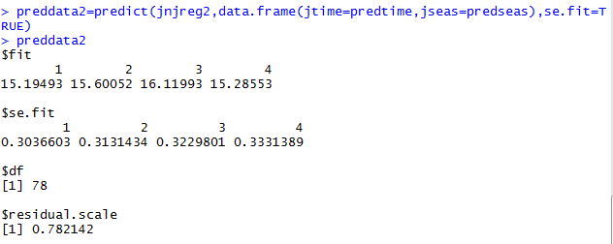
Forecasts

Slide 59
Confidence interval
predvalues2=preddata2$fit
prederror2=preddata2$se.fit
predupperse2=predvalues2+2*prederror2
predlwrse2=predvalues2-2*prederror2

Slide 60
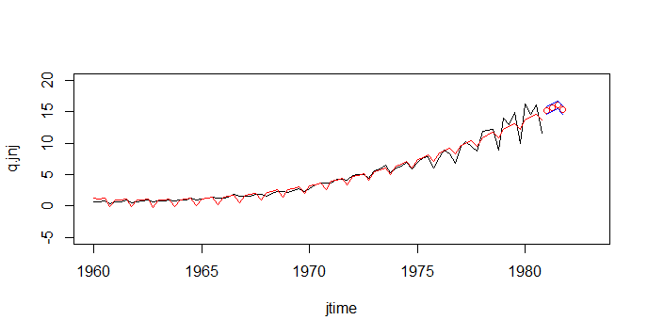
Plots
plot(jtime,q.jnj,ylim=c(-5,20),xlim=c(1960,1983),type='l') lines(jtime,jnjhat2,col='red') points(predtime,predvalues2,col='red') lines(predtime,predupperse2,col='blue') lines(predtime,predlwrse2,col='blue')

Slide 61
Example: Temperature series
From the Global series, the parameters of a straight-line trend wit additive seasonal indices can be estimated for the temperature series (1970-2005) as follows:
global <- read.table("C:/MA_TS/R/global1.dat")
global <- ts(global, st = 1856, fr =12)
temp <- window(global, start = 1970)

Slide 62
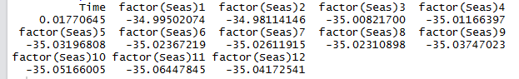
Example: Temperature series
From the Global series, the parameters of a straight-line trend wit additive seasonal indices can be estimated for the temperature series (1970-2005) as follows:
> Seas <- cycle(temp)
> Time <- time (temp)
> temp.lm <- lm(temp ~ 0 + Time + factor (Seas))
> coef(temp.lm)

Slide 63
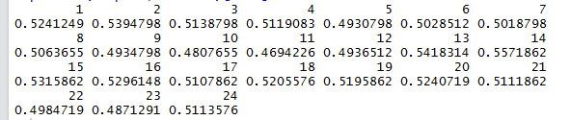
Example: Temperature series
Using the fitted model, a two-year ahead future prediction for the temperature series is obtained as follows:
> new.t <-seq(2006, len = 2*12, by = 1/12)
> new.dat <- data.frame(Time = new.t, Seas = rep(1:12,2))
> predict(temp.lm, new.dat)[1:24]

Slide 64
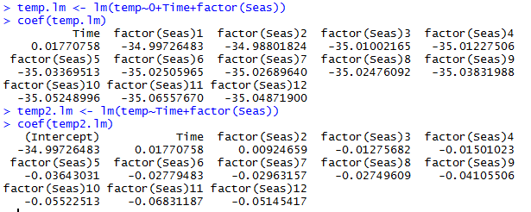
Difference between models with and without an intercept

